Slide 1
IETF Hackathon: MUD and Onboarding
IETF 105
20-21 July 2019
Montreal

Slide 2
Hackathon Plan
MUD - RFC 8520
MUD Reporter – develop a means to report config errors to network manager and manufacturer
MUD Maker – make code maintainable
Build out and validate SECOM MUD capability
DPP/MUD integration
Verification and MUD file generation: incorporate East/West and North/South filters for verification
BRSKI – draft-ietf-anima-bootstrapping-keyinfra
Improve ANIMA ACP GRASP discovery
<What drafts/RFC’s were involved?>
<Specific problems to solve>
How you planned to solve it? Plan?! What plan?!

Slide 3
What got done
MUD Maker php code can be deleted. Rewritten by HomeNet team in python. Now maintainable!!
Lots of testing of WFA EasyConnect/DPP with MUD and Micronets Gateway
A whole lot of thinking about what to report to network manager and manufacturers when things worked and didn’t
NIST implementation already 80% complete
SECOM mud validated against two or three separate MUD managers
https://github.com/CiscoDevNet/MUD-Manager
https://github.com/usnistgov/MUDPI
https://github.com/usnistgov/nist-mud

Slide 4
More of what got done
Four separate MUD Manager implementations at the table:
2 using OpenWRT
1 using OpenFlow
1 using Radius and DACLs
All demonstrating consistent behavior (as far as we tested)
East/West and North/South filters completed in verifier
Filtering between devices TBD

Slide 5
What we learned
Core MUD RFC looks reasonably good so far
MUD Reporter draft needs a lot of discussion
Organization of reporting elements
What do manufacturers want?
How to aggregate?
Failing hard is good

Slide 6
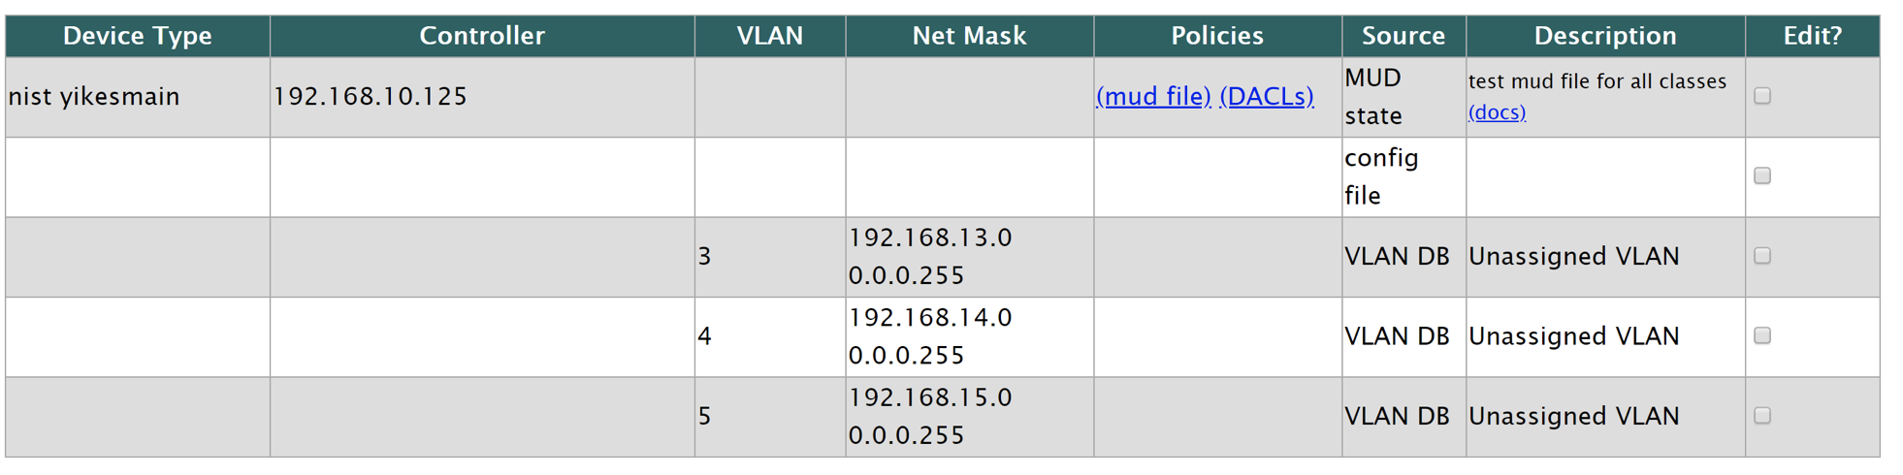

Slide 7
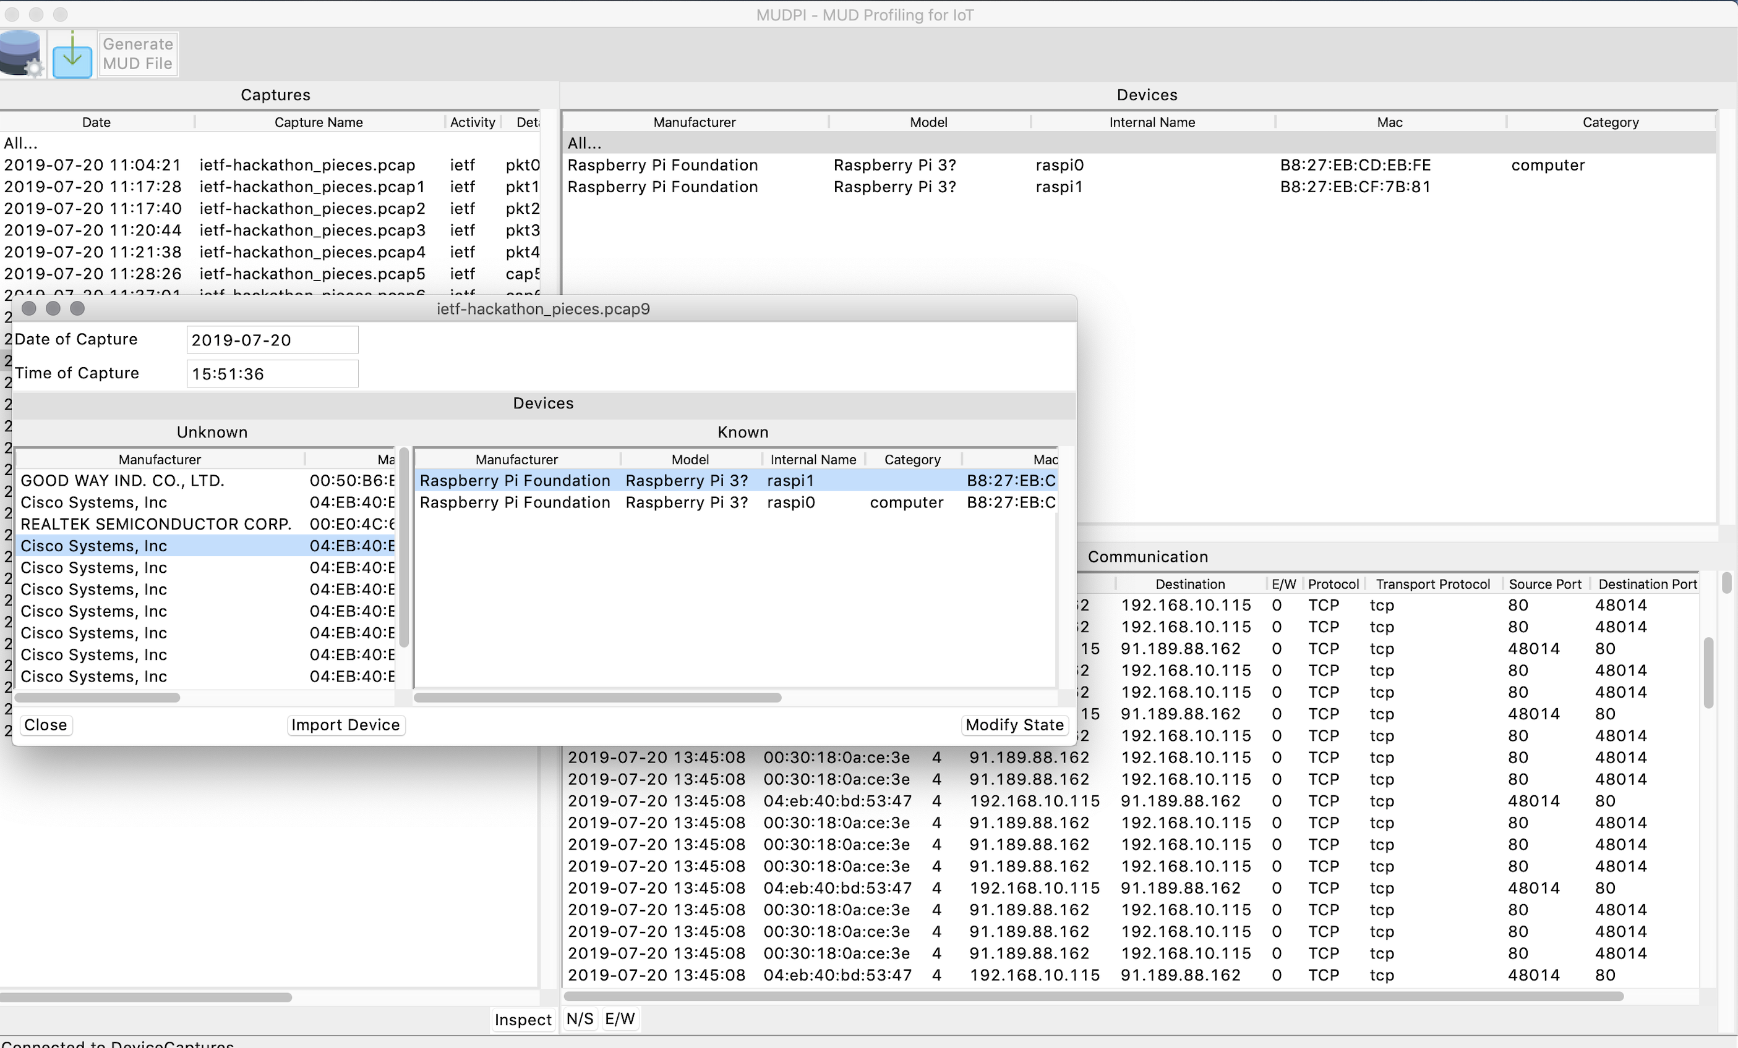

Slide 9
Wrap Up
Team members:
Paul Watrobski*
Michael Richardson
Joshua Klosterman*
Tadahiko Ito*
M. Ranga*
Tim Polk*
Lucas Estienne*
Daniel Innes*
Vijay Sati*
Bill Atwood
Yoichi Takita*
Darshak Thakore*
Eliot Lear
Murugiah Souppaya*
* First Time
Mailing lists:
mud@ietf.org
iot-onboarding@ietf.org
Thank you to NIST NCCoE, CIRA HomeNet, Concordia, SECOM, Michael Richardson, Cable Labs, Cisco, Mitre

